Slide 1
Merton Safeguarding Children Partnership Learning from the Child Q Review
Full Partnership, 15th June 2022
Notes:
Introduce self and role – make this clear that I present this as a statutory member of the partnership and so with one third of a police hat on.

Slide 2
Child Q - Learning Review from Hackney
Overview: Child Q, a Black female child of secondary school-age, was strip-searched by female police officers from the Metropolitan Police Service. It took place on school premises, without an Appropriate Adult present, and with the knowledge that Child Q was menstruating.
Report available online: Child-Q-PUBLISHED-14-March-22.pdf (chscp.org.uk)

Slide 3
Learning from Child Q in Merton
Published our statement on Child Q to help reassure professionals, children and families in Merton (March 2022):
MSCP response to Child Q Review - Merton Safeguarding Children Partnership (mertonscp.org.uk)
Sub-group chairs and Exec review of Merton partners' procedures and processes, and current work to address themes from Child Q case across the Partnership (April 2022)
Considering what more we can do locally to learn from the Child Q Review
Adultification to be the priority theme for scrutiny for this financial year. What more could the MSCP do to prevent the adultification of children in Merton?

Slide 4
Key Themes
Engaging in Healthy, Professional Challenge: The review highlighted the importance of practitioners having the confidence and secure knowledge to uphold the best interests of children; to effectively challenge other professionals and, should it be needed, the ability to escalate to senior managers/ safeguarding leads.
Adultification/Disproportionality of Black Children: As part of the review, several agencies highlighted that the term ‘adultification’ and the issue of adultification of Black children and its impact is not necessarily well understood among the workforce, especially those not in safeguarding roles.

Slide 5
What are we doing in Merton?
Engaging in Healthy, Professional Challenge
The MSCP agreed Escalation Policy, publicly available on our website.
"Open forum" events to consider healthy professional challenge being planned.
Commissioned training by Inner Strength Network on having "difficult conversations" to support practitioners
Representatives from the Police meet monthly with all secondary heads at the Hard to Place panel meeting, which is part of the Safer Schools Partnership.

Slide 6
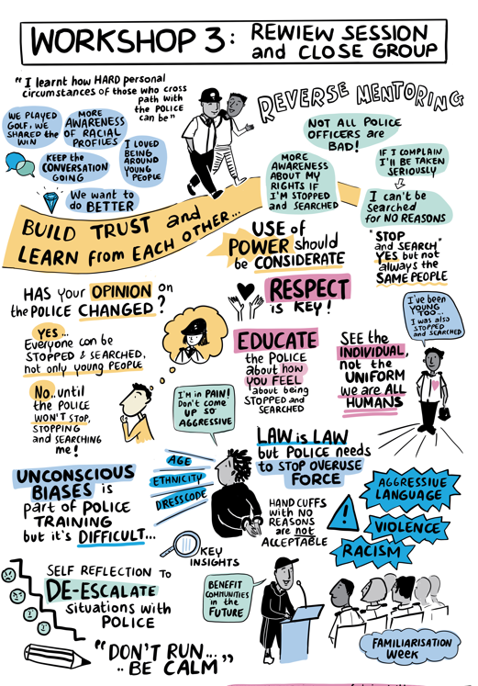
What are we doing in Merton?
Adultification/Disproportionality of Black Children
Section on MSCP website on racism and discrimination in the ‘children and young people’ section with links to further information, though it could be further developed.
Disproportionality Task Group set up by the Youth Crime Prevention Executive Board.
"Reverse Mentoring" via Stop and Search workshops.
Considering commissioning training on Adultification from Listen Up
Visual minutes taken from the Stop and Search Workshop 03/11/21

Slide 7
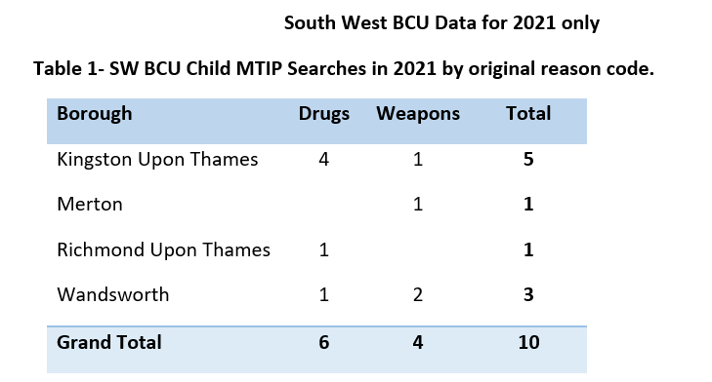
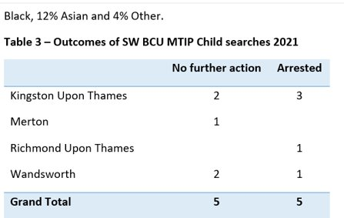
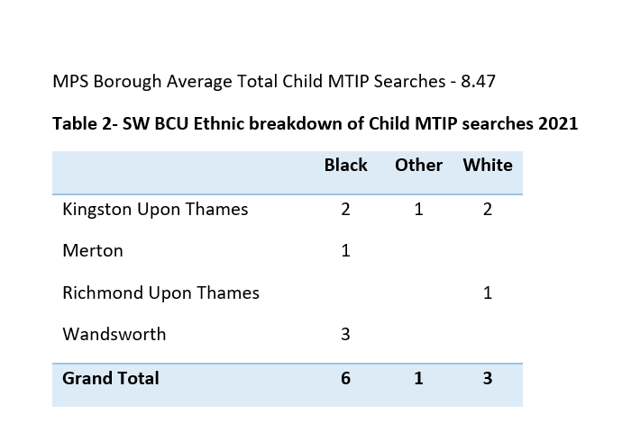
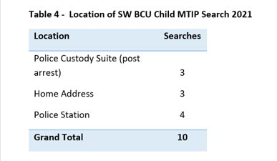
More Thorough Search Where Intimate Parts are Exposed (MTIP)

Slide 8
Recommendations for Merton
Consider learning from Child Q at the Full Partnership and what more we can do as a partnership to address the lessons learned
Consider how to better engage with the wider community (including children, young people and parents) on awareness raising campaigns relating to our key safeguarding priorities and the work we do
Consider training needs, particularly around Adultification, healthy professional challenge and ensuring safeguarding training includes an emphasis on our duty to 'uphold the best interests of children'
Consider Adultification as a topic for further scrutiny (being taken forward by our Scrutineer and Young Scrutineer)

Slide 9
Time to Reflect
What do you understand by the term adultification?
How confident do you feel about healthy, professional challenge and what it means?
How could MSCP support you / your organisation in being confident to offer healthy, professional challenge?
This Photo by Unknown author is licensed under CC BY-SA-NC.

