Slide 1
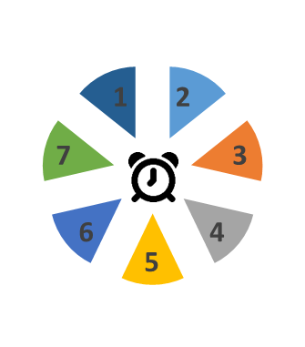
Learning from Reviews – "Eddie" February 2021
Summary
Eddie, 16 yr old boy, Mixed Heritage (Mother White British; Father Afro Caribbean)
Took overdose of 9 Ibuprofen following argument with a friend and negative comments from his father. Followed four previous incidents of self-harm since 2016.
Mother called 999. He was taken to hospital- left hospital same day.
Eddie had gone to maternal grandmothers – returned home once advised by his mother she would ask Police to call off search.
Eddie agreed to attend an appointment with CAMHS rather than having a MH assessment over the phone which he did not attend.
Themes
Think Family
Family members had their own emotional and physical health needs – but plans focused on child as individual or were service based for family members. No network meeting for all relevant people effective in creating change.
Sometimes an over-optimism of family’s ability to support Eddie without a ‘Think Family’ approach – CSC should have held Team around the Family (TAF) when ending social care involvement.
Constructive Challenge
Agencies should have constructively challenged each other about commitment and responsibility.
A case discussion could have mapped out the worries for Eddie, family and professionals and agreed who would do what and the timescales for each member of the network.
Contextual Safeguarding/Harm
Service provided to Eddie was affected by preconceptions of Eddie and his family.
Eddie clear that he wanted to be in education – possible racism in the form of low expectations, Youth Justice Service first involved when Eddie was just 12
Gaps in knowledge from some agencies of possible gang affiliation, county lines and drug use – police did not always share information with CSC about stop and search.
Need consideration around who is best to provide Return Home Interviews, e.g. trusted person.

Slide 2
Learning from Reviews – "Eddie"
Trauma-informed practice/ Self-Harm and Suicide Prevention
Eddie experienced significant adversity and trauma in childhood
Risk that behaviours are ‘explained away’ due to traumatic history but important for workers to continue to review incidents and understand triggers of behaviour.
Adolescents can turn to destructive behaviours to avoid or diffuse intense negative emotions that accompany traumatic stress, including self-harm. Focus should be on ‘What has happened to you?’ rather than ‘What is wrong with you?’
Planning/ Step Down or Up
Plans to increase safety and reduce risk should be family and community based with the support of professionals
Eddie has been supported to manage distress – and protective factors within himself, his family and the professional network have halted an escalation to a more complex situation.
However, there was sometimes over-optimism of family ability to meet Eddie's needs without a ‘Think Family’ approach – need TAF when making decision to end social care involvement
Complex case discussions should take place when considering re-referral to CSC
Need to understand Eddie and family’s worries and concerns about plans and consider alternatives
Strength-based work needed more in working with adolescents who have experienced trauma
Practice Improvements
Reviewing implementation of the Lammy Review recommendations re organizational, structural and environmental racism.
Agreeing ‘Think Family’ approach with practical tools to deliver – including a ‘family friendly’ template for a single plan designed with service users; guidance about who can lead a TAF, how and when takes place.
Improving understanding and utilization of escalation procedures
Improving understanding of contextual harm – including awareness of self-medication to manage trauma
Consider training in trusted adult approach (e.g. AMBIT)

