Slide 1
How well are MSCP working with partners to respond to sexual harassment in schools and colleges?
Halima Mehmood, MSCP Young Scrutineer (YS)
Sarah Lawrence, MSCP Independent Scrutineer (IS)

Slide 2
Sexual Harassment:
This is unwanted behaviour of a sexual nature which violates your dignity, makes you feel intimidated, degraded, or humiliated, and creates a hostile or offensive environment.
This can include:
Sexual comments or jokes, physical behaviours including unwelcome sexual advances, touching, and various forms of sexual assault.
Displaying pictures, photos, or drawings of a sexual nature.
Sending messages with a sexual content.

Slide 3
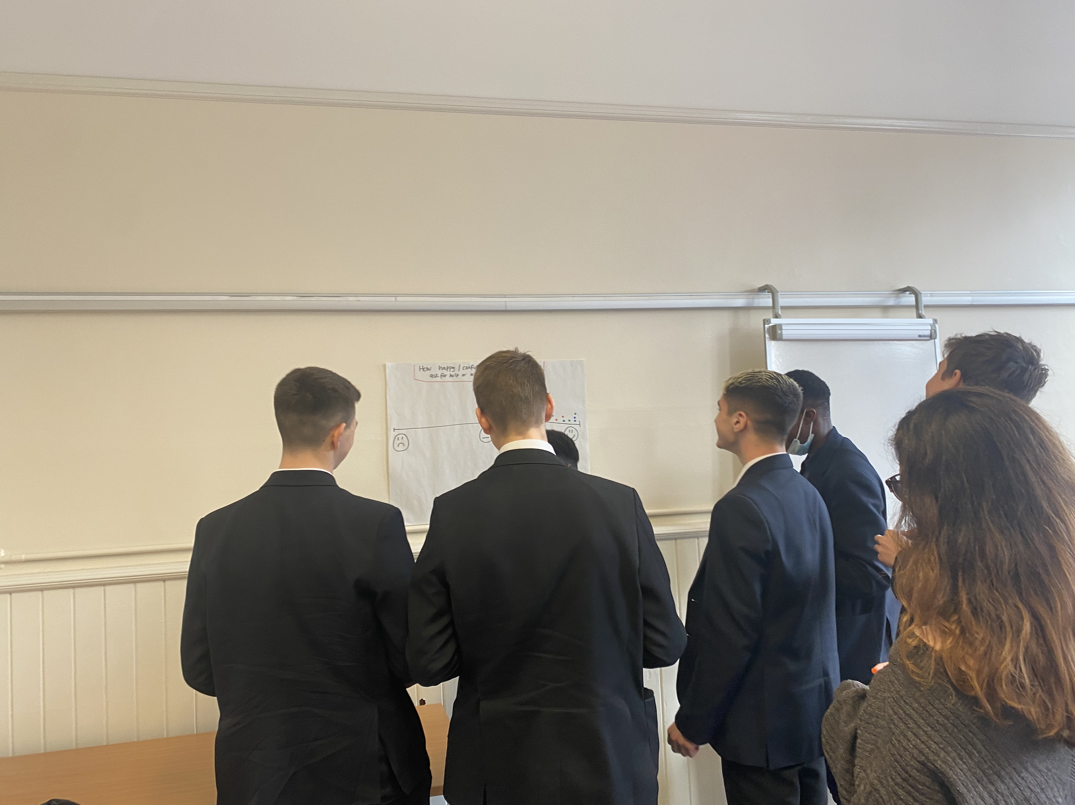
Methodology:
IS and YS joint scrutiny, over 4 days
Light touch literature review
Focus groups / meetings with students
Meetings with school leaders, MSCP, partners
Survey opportunity for all schools

Slide 4
National Context / Literature Review
Sexual harassment is common place
Adults and children experience it
Mostly female
Links to sexual abuse and exploitation
Children rarely speak to adults about sexual harassment
Fear around how adults will react to disclosures
Recommendations for SCP’s led to this scrutiny.

Slide 5
What children told us….
“I’d speak my history teacher, I trust her”
“I’d speak to my head of year. He’s young and approachable”.
Sexual harassment is spoken about a lot at school.
Didn’t think about it being written online or over social media.
Things can happen outside of school, can be with other schools' students.
Anonymous reporting is a good thing. There is a lot of stigma attached to telling someone about SH.
School makes our feelings feel valid, e.g. they say ‘banter’ is not an excuse.
The rape statistics, BLM issues, Sarah Everard case…they put you off reporting to police. Seeing better responses to smaller issues would help build our trust
“…not sure when something should be reported to places other than school…”
We have to trust the people before we’d tell them or report SH. If we have a bad experience before it puts us off telling them something so personal.
I would always speak to my friends first….
I might speak to my family, usually my parents or a sibling…
If you are worried about sexual harassment you can put something in the ‘wory box’ at school

Slide 6
Findings – Current Context
Culture of “It could (and does) happen here” seen / felt in scrutiny
Varying levels of responses to Everyone’s Invited – not all participated
In a key moment in time – needs to be sustained, risk of moving on to next topic
Merton wide coordinated community response to this topic is needed, currently unclear where this sits in MSCP / Merton.

Slide 7
Findings – Current Context
Schools safeguarding audit contains questions about this topic, just over half (56%) of schools responded so far.
Sexual Harassment should not be seen in isolation from other safeguarding issues (e.g. contextual / exploitation)
Some settings clearly developing their approach, keen to share resources and learning – across ages / stages and wider partnership
Schools would like more opportunities to discuss with partners beyond meetings about incidents.

Slide 9
Findings – Current Context
Varying language used across partnership and in settings, could unintentionally adultify or minimise child experiences & risk
(e.g. abuse ‘in relationships’, peer on peer, young people)
Topic has been spoken about for last year – 18 months – mainstream settings
Current policy (& responses) could be more disability inclusive
A few settings are working with their students to coproduce campaigns and check responses
Toxic masculinity is a bigger community issue than just in school / college
‘Banter’
‘Boys will be Boys’
Notes:
- Disability Inclusive – policy not relevant for special schools

Slide 10
Findings - Reporting
Confidence and ability to report ‘officially’ is affected by
Intersecting issues and barriers – most notably due to race, disability, sexual orientation, gender identity
Past experience / others experience of services
Lack of clear information provided to children about how to report (outside of education)
Children reflected they are most likely to speak to friends first
Most likely to report where they felt the incident was serious and they had high confidence in the person e.g. trusted school staff (year head, tutor, safeguarding lead).

Slide 11
Findings - Reporting
Less confident to speak to statutory services, not sure how to report and what implications are
Lack of knowledge about legal / statutory consequences of harassment and abuse (both students and practitioners).
Children need a variety of reporting avenues
Children would prefer anonymous reporting especially for less serious issues – some schools skeptical of this.
Children feel worried about consequences of telling someone what is happening.

Slide 12
How happy / confident do you feel about reporting sexual harassment?
1
10

Slide 13
Findings - Responding
Limited awareness of MSCP policy / guidance, incl. for Harmful Sexual Behaviours among practitioners
Settings have developed their own policies / procedures and innovation
HSB guidance needs refreshing, in the light of policy and practice developments and to ensure it is inclusive
Clarity requested / needed in terms of responding to incidents that occur:
off school premises, in the community, at parties….
online
where students are from different schools
And, where incidents don’t meet ‘statutory’ threshold but are between students from different settings.

Slide 14
Findings – Detail by setting type
Early Years:
Not included in scrutiny at this stage
Good practice / prevention work in concept stage but not evident at this stage in literature review.
Primary:
Started to discuss and recognise how SH manifests itself in younger children
Would like more opportunities for discussion with other schools & partners
Support with identifying age appropriate resources to use in work with children.
Secondary:
Responding to everyone's invited, developing responses, moved quickly
Would like support with ‘non statutory’ level cases / MSCP guidance e.g. HSB
RSE work taking place, including externals for some (Beyond Equality) – issue of sustainability
Reporting systems in place, some include anonymous – others skeptical about this.
Support in engaging parents, communities
Independent
Specialist, focused work and roles created, after Everyone’s Invited
Affluent families – a different angle on neglect is present
Support in engaging parents, communities
Available resources to invest in specialist roles and services e.g. Lime Culture – Sexual Misconduct Liaison Officer (SMLO)
SEND / Special schools
Low confidence about reporting bad experiences esp. personal subjects like this
Less access to safer schools officer
Disabled children more at risk
Feel ‘generic’ policies like HSB don’t work for them.
College/Further Education
Work with RASASC to develop an in college campaign, could be used more widely in Merton
Workshops with students ongoing
Specialist funded support from RASASC

Slide 16
Recommendations for MSCP
Identify a strategic place for sexual harassment and abuse to ‘sit’ within MSCP
Develop and promote innovative ways that children can report sexual harassment and abuse, including:
Anonymous reporting / online options
Beyond education settings, e.g. ‘safer streets’ app as a way of reporting locations
Support education settings to routinely share good practice on this topic with each other & the wider partnership
Support early years and primary schools to develop their responses to this topic
Work with children and young people, especially those that have lived experience of sexual harassment and abuse, to regularly review success of responses (in school and wider services).

Slide 17
Recommendations for MSCP
6. Ensure equitable provision of safer schools officers across school type including special schools
7. Refresh HSB policy with schools / colleges reps including special schools
8. Consider delivery of multi agency training on SH and abuse, including a child perspective, referencing:
Intersecting barriers (race, gender, sexual orientation, disability) & past experience impact confidence and trust
Child focused language and responses – e.g. child on child (rather than peer on peer) abuse.
9. Raise awareness of risks and challenge attitudes to sexual harassment in wider community – include practitioners, parents.

Slide 18
Next Steps
Present to MSCP, Exec and Education leads
Provide easy read version feedback to participants / all settings
Support further work as requested.

